Slide 1

CSE 163
Performance + Profiling
Hunter Schafer

Slide 2
Notecards
At the end we will be doing an activity to help people to find partners for the project
If you are still looking for a partner, on the notecard write
Your name
An area you are most interested in looking into for the project
E.g. biology, astronomy, social networks, etc
We will collect those and talk about an activity at the end
If you already have a partner or don’t want one, congrats, you have won a brand new notecard
Don’t turn it in

Slide 3
Method 2: Count steps
Assumption: A single simple line of code takes the same amount of time to run in Python.
Examples:
num = 5 + 10;
print(“hello);
x > 5 and x % 2 == 0
num = 5 + 10
print(“hello”)
num > 5 and num % 2 == 0
Rules:
Loop runtime is number of times it is run (N) times the number of statements
Method runtime is sum of all statements found inside of it.

Slide 4
Growth rate
We often think of algorithms in terms of growth rate in terms of the input or input data size (n)
Think of the runtime of 5n³ + 4n² + 3n + 7.
All terms seem significant when we look at smaller inputs.
However, what happens when n becomes extremely large? At that point the term with the largest power of n will dominate (n³).
We say it runs on the order of n³ or O(n³) (Big Oh of n cubed).

Slide 5
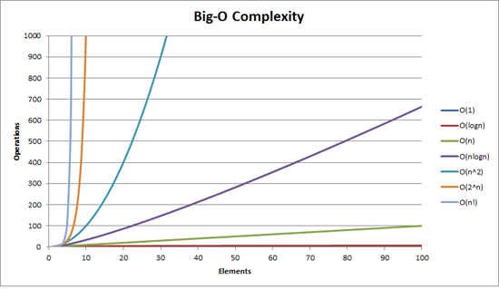
Complexity classes
http://recursive-design.com/blog/2010/12/07/comp-sci-101-big-o-notation/ - post about a Google interview

Slide 6
1 min - Review
What are the Big-O run-times of each of these methods?
def max_diff1(nums):
max_diff = 0
for n1 in nums:
for n2 in nums:
diff = abs(n1 - n2)
if diff > max_diff:
max_diff = diff
return max_diff
def max_diff2(nums):
min_num = nums[0]
max_num = nums[0]
for num in nums:
if num < min_num:
min_num = num
elif num > max_num:
max_num = num
return max_num - min_num
def max_diff3(nums):
return max(nums) - min(nums)

Slide 7
1.5 min - Review
What are the Big-O run-times of each of these methods?
def max_diff1(nums):
max_diff = 0
for n1 in nums:
for n2 in nums:
diff = abs(n1 - n2)
if diff > max_diff:
max_diff = diff
return max_diff
def max_diff2(nums):
min_num = nums[0]
max_num = nums[0]
for num in nums:
if num < min_num:
min_num = num
elif num > max_num:
max_num = num
return max_num - min_num
def max_diff3(nums):
return max(nums) - min(nums)

Slide 8
Big-O
Pros
Simple to describe how an algorithm will scale
Independent of programming language / computer
Easy to think of (with practice 😊)
Cons
Can be a bit overly simplistic (a very crude approximation)
Misses many important issues of performance that matter in real life
Constants can sometimes really matter

Slide 9
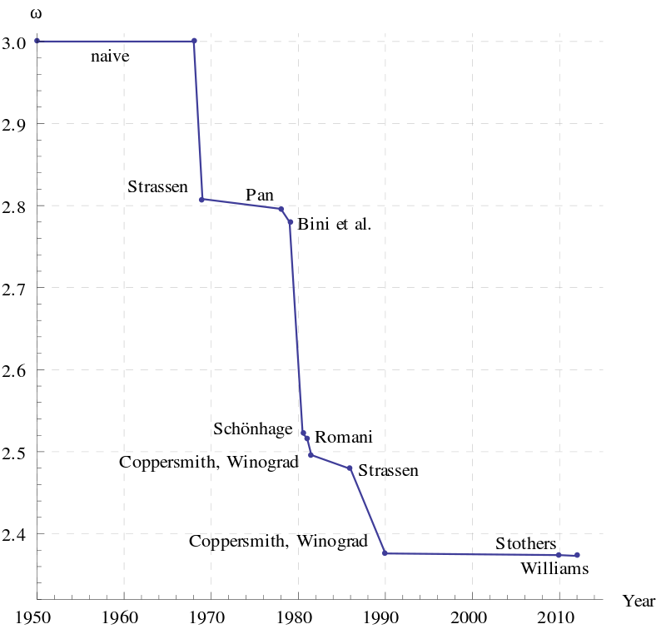
Matrix Multiplication

Slide 10
Big-O
In theory, Big-O is a great descriptor, but in practice we generally also include timing information to help us reason about our program efficiency
It makes no sense to talk about one or the other, a good computer scientist uses both tools appropriately
Big-O
Helps us communicate how our algorithm scales
Great tool to easily eliminate algorithms that won’t scale
Timing
Verify our implementation is fast
Help us find bottlenecks in our algorithm

Slide 11
1 min
Rank the algorithms in term of their speed on my computer
“1=2 < 3” means 1 and 2 are about the same, but faster than 3
def max_diff1(nums):
max_diff = 0
for n1 in nums:
for n2 in nums:
diff = abs(n1 - n2)
if diff > max_diff:
max_diff = diff
return max_diff
def max_diff2(nums):
min_num = nums[0]
max_num = nums[0]
for num in nums:
if num < min_num:
min_num = num
elif num > max_num:
max_num = num
return max_num - min_num
def max_diff3(nums):
return max(nums) - min(nums)

Slide 12
1 min
Rank the algorithms in term of their speed on my computer
“1=2 < 3” means 1 and 2 are about the same, but faster than 3
def max_diff1(nums):
max_diff = 0
for n1 in nums:
for n2 in nums:
diff = abs(n1 - n2)
if diff > max_diff:
max_diff = diff
return max_diff
def max_diff2(nums):
min_num = nums[0]
max_num = nums[0]
for num in nums:
if num < min_num:
min_num = num
elif num > max_num:
max_num = num
return max_num - min_num
def max_diff3(nums):
return max(nums) - min(nums)

Slide 13
Timing
Generally two ways to time programs
Time the whole program
Use a profiler to help you see the time spent on each line
If you are timing the whole program, you need to run it multiple times to get a good idea of the total run-time
If you use a profiler, you usually don’t care about the raw times, but rather relative times
For profiling, I usually use the line_profiler package (kernprof)
In your terminal
conda install line_profiler
kernprof -v -l file.py

Slide 14
Why is Python Slow?
Interpreter
We have mentioned before that when we are using Python, we are using an interpreter rather than a compiler
This means it has to figure how to translate your code while it is running
This can be overly slow in “hot” loops
Dynamically types
We don’t have to write down the types ahead of time, which means Python spends a fair bit of time figuring out which type each object is

Slide 15
Example: Arithmetic
Consider this C program
This roughly maps to the machine instructions
/* C code */
int a = 1;
int b = 2;
int c = a + b;
Assign <int> 1 to a
Assign <int> 2 to b
call add<int, int>(a, b)
Assign the result to c

Slide 16
Example: Arithmetic
Consider this Python program
This roughly maps to the machine instructions
# A Python program
a = 1
b = 2
c = a + b

Slide 17
Example: Arithmetic
1. Assign 1 to a
1a. Set a->PyObject_HEAD->typecode to integer
1b. Set a->val = 1
2. Assign 2 to b
2a. Set b->PyObject_HEAD->typecode to integer
2b. Set b->val = 2
3. call add(a, b)
3a. find typecode in a->PyObject_HEAD
3b. a is an integer; value is a->val
3c. find typecode in b->PyObject_HEAD
3d. b is an integer; value is b->val
3e. call add<int, int>(a->val, b->val)
3f. result of this is result, and is an integer.
4. Create a Python object c
4a. set c->PyObject_HEAD->typecode to integer
4b. set c->val to result

Slide 18
Slow Python
If Python is so slow, why does anyone use it?
It is WAY easier to program with than a language like C
Developer time costs $$$, computers are cheap
Python provides incredible support for plugging into pre-compiled libraries
Examples: pandas, sklearn, numpy, scipy
Pretty easy to get around this
Use a profiler to figure out where your bottlenecks are
If your program is slow, look to any “hot” loops that might be replaced with library calls.

